Slide 1
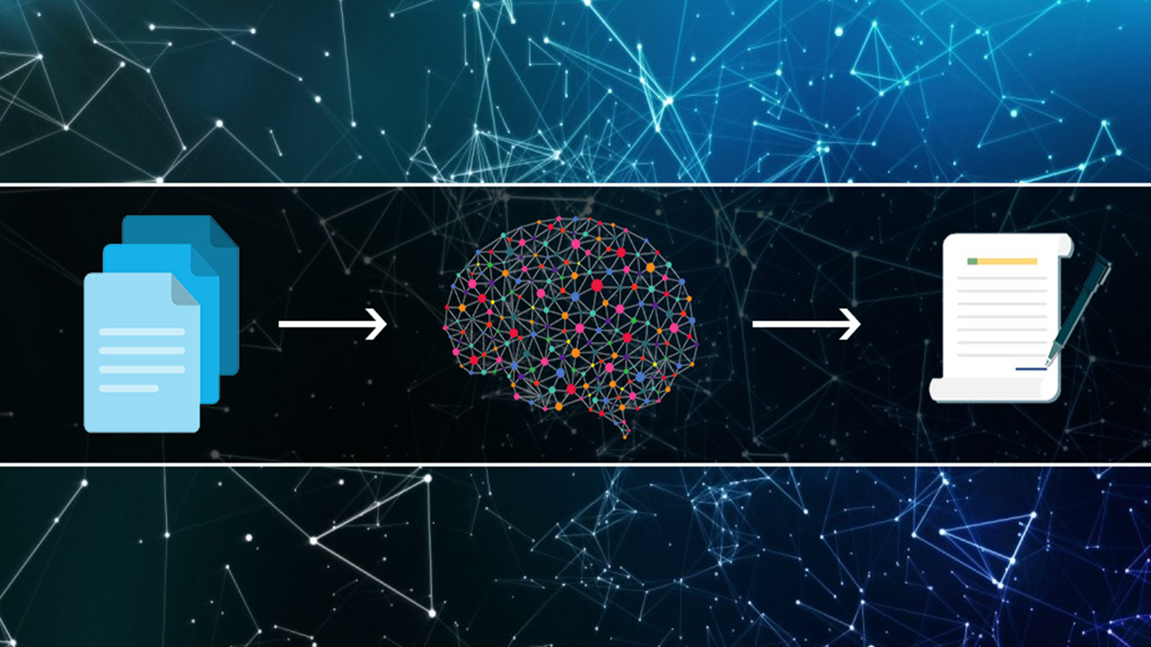
TEXT SUMMARIZATION
TEXT SUMMARIZATION
1602-19-737-006 – AVANISH REDDY
1602-19-737-014 – GOVIND CHANDAK
1602-19-737-045 – G.SREE MAHALAXMI

Slide 2
ABSTRACT
Automatic text summarization is the task of producing a concise and fluent summary while preserving key information of the content and overall meaning using machine learning. It takes care of choosing the most significant portions of text and generates coherent summaries that express the main intent of the given document. The main idea of summarization is to find a subset of data that contains the “information” of the entire set.
In today’s world, data generation and consumption are exploding at an exponential rate. Due to this, text summarization has become the necessity of many applications such as search engines, business analysis, market reviews, etc. Automatic text summarization involves producing a summary of the given text document without any human help. It is a viable solution to reduce the information overload problem on the web and to reduce time instead Of reading the whole text file. It provides quick Information from large documents.
Text summarization is of two types- Abstractive summarization and Extractive summarization. In this project, we focus on Extractive summarization. It focuses on extracting objects directly from the entire collection without modifying the content Itself. Extractive summarizers take sentences as the input and produce a probability vector as output. To produce the final summary best sentences are chosen according to the required summary length.

Slide 3
Problem Definition
For example, if a student has to write a maximum amount of words for an article, essay, report, or story you name it, The Automatic Text Summarization website will help to make sure its word count reaches a specific requirement or stays within a certain limit.
This helps the student form precise and accurate summaries, which gives a recap of the entire text in a condensed manner saving time needed for understanding the text.
This is also handy if a student is preparing for an exam that has loads and loads of material to study from.

Slide 4
Refined Problem Definition
In our daily life, we can see many articles on the same concept in different newspapers. Everyone has different expository writing styles.
For example, if there is an article related to the Ukraine war in The Hindu newspaper and the same article in the Times of India with a different way of narrating.
Then our website Text Summarization is used to compare the text of different articles, summarize the contents of all text, and provide the overall meaning of the idea.
And also identifies which one is the best among them.

Slide 5
TF-IDF :
TF-IDF (Term frequency-inverse document frequency) is a method which gives us a numerical weightage of words which reflects how important the particular word is to a document in a corpus.
TERM FREQUENCY (TF): The weight of a term that occurs in a document is simply proportional to the term frequency.
TF(t , d) = count of term in document / number of words in document
DOCUMENT FREQUENCY (DF): DF is the count of occurrences of term t in the document set N
DF(t) = occurrence of t in documents
Inverse Document Frequency(IDF): Inverse document frequency factor is incorporated which diminishes the weight of terms that occur very frequently in the document set and increases the weight of terms that occur rarely.(ex : Stop words)
IDF(t) = log(N/(DF + 1))
Overall Formula :
TF-IDF(t, d) = TF(t, d) * log(N/(DF + 1))

Slide 6
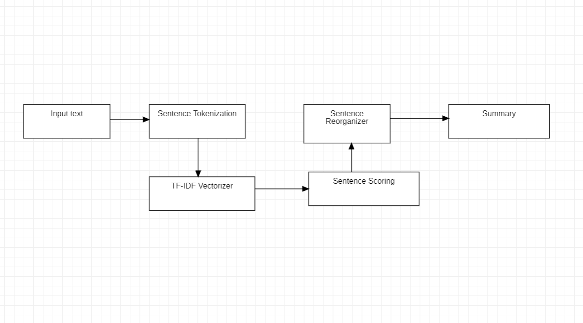
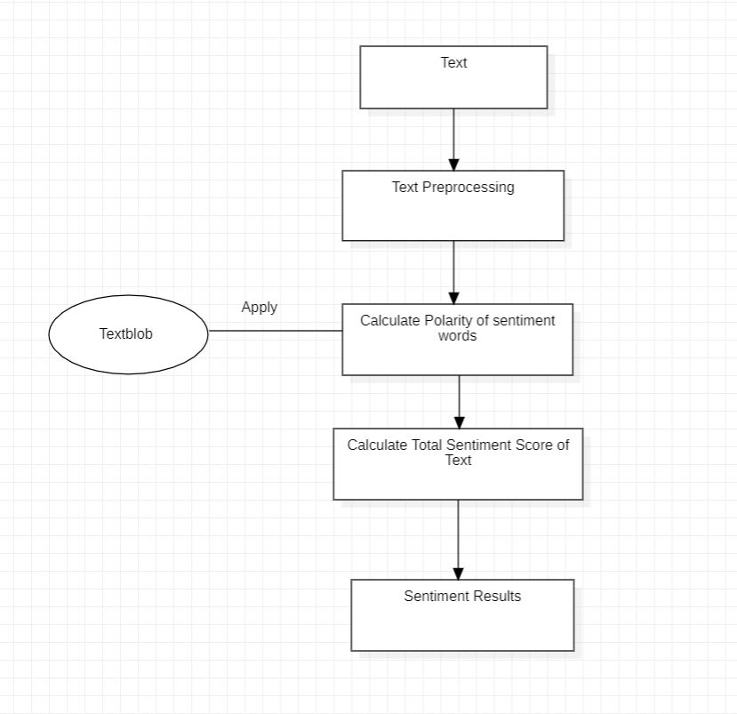
Algorithm for Summarization and Tone checker :

Slide 7
Overall architecture
1 . Login and Register
2 . Text summarization(by text)
Provides you the summary of the text using the Extraction method.
3 . Named Entity Recognition
Named Entity Recognition can automatically scan articles and reveal which are major people, organizations, and places discussed in them. It adds a wealth of semantic knowledge to your content and helps you to promptly understand the subject of any given text.
4 . Text Relationship
It gives parts of speech of each token in the sentence.
5 . Tokenization
Tokenization breaks the raw text into words, sentences called tokens. These tokens help in understanding the context or developing the model for the NLP.

Slide 8
EXTENDED SCENARIOS :
6. Text summarization (by URL, uploading file, uploading multiple files)
Summarizing text in given URL and file.
7 . Text to Speech
You can listen to your summarized text and also generates text by speech.
8 . Grammar
It provides meaning, Part of Speech, Synonym, Antonym, definition, and example of the given text. It works by comparing every word typed with thousands of correctly spelled words and then uses algorithms to determine the correct spellings in NLP.
9 . Comparing different articles
Comparing text of different articles of the same idea.

Slide 9
Libraries used :
Summarization by text :
Gensim, nltk
Summarization by URL :
Bs4, urllib
Summarization by uploading a file :
Docx2txt, pyPDF2, pdf plumber
NER :
Spacy
Text to Speech :
os , time, gtts
File Processing :
Pandas, Docx2txt, PyPDF2 , PdfFileReader , pdf plumber

Slide 10
SOFTWARE REQUIREMENTS
Django for frontend
Streamlit for backend
Visual Studio Code
Web Browser
FRONT END TECHNOLOGIES :
HTML, bootstrap, CSS, Jinja for Django templates
BACK END TECHNOLOGIES :
Python
HARDWARE REQUIREMENTS
Operating System – Linux/Windows
Hard Drive – 16 GB
RAM – 1GB

Slide 11
References :
https://medium.com/luisfredgs/automatic-text-summarization-with-machine-learning-an-overview-68ded5717a252
https://www.mygreatlearning.com/blog/text-summarization-in-python/
https://www.youtube.com/watch?v=eWKg4Id30_k
https://www.youtube.com/watch?v=ryQVfi580OI&feature=youtu.be
https://www.analyticsvidhya.com/blog/2019/06/comprehensive-guide-text-summarization-using-deep-learning-python/

